Slide 1




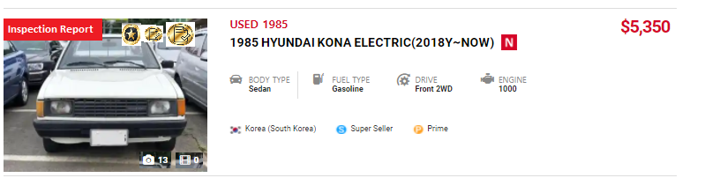
Badge Design (FINAL)
Rooker will do
KAFESTA Alliance
카페스타 얼라이언스
Official Certified
Inspection Report
차량 성능기록부
Mileage Guarantee
마일리지 보증
Gov. Registration
Vehicle Certificate
자동차등록증
Sample

Slide 2
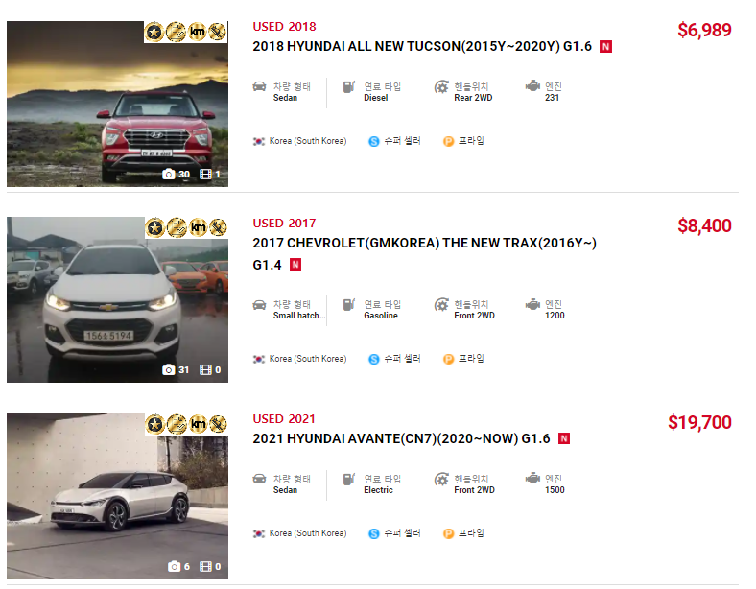
Badge Design (FINAL)
Rooker will do
The Badge Location will be like this.
Pls make it FIX.

Slide 3
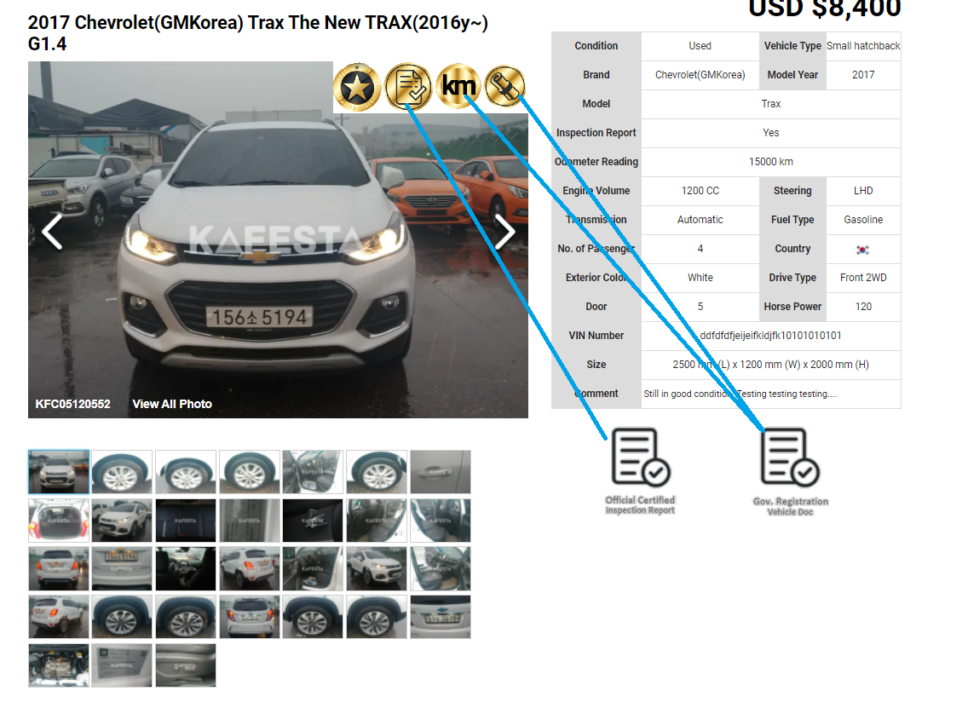
Badge Design (FINAL)
Rooker will do
When Seller upload 'Official Certified Inspection Report', the Badge will automatically appear in the photo.
When Seller upload 'Gov. Registration Vehicle Doc', The two Badge (Mileage Guarantee & Gov Registration Vehicle Certificate') will automatically appear in the photo.
(make sure, you put 'Tool Tip' function, so when internet user, move their MOUSE at the Badge, each name will appear)

Slide 4
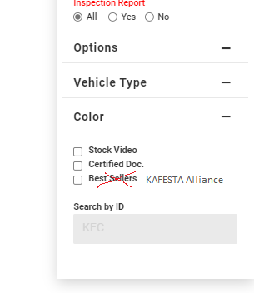
Badge Design (FINAL)
Rooker will do
KAFESTA Alliance
카페스타 얼라이언스
KAFESTA Alliance: This is for a Seller who is a Strong partner with KAFESTA (Exclusive Partner)
So basically, when they make ‘Exclusive’ agreement with KAFESTA, we will give them this Badge.

